Slide 1
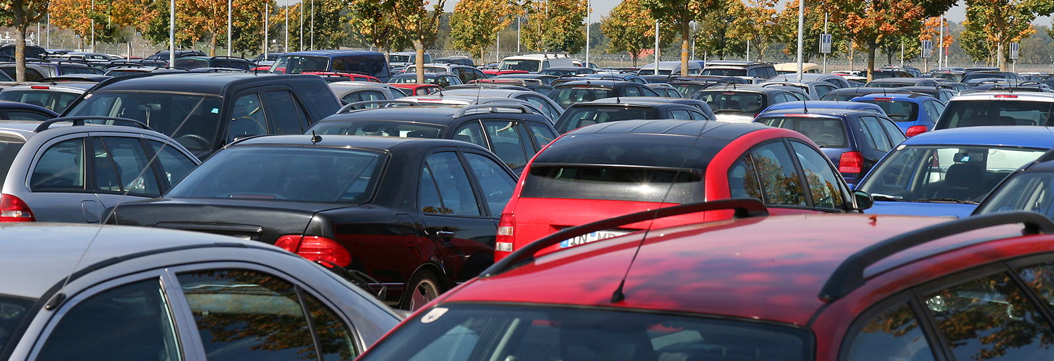
Car Auction Price Analysis: continue and recommendations
Group: T9 Hongwei Zha

Slide 2
Table of Contents
Feature Selection
Dimensionality Reduction with PCA
Recommendation Engine

Slide 3
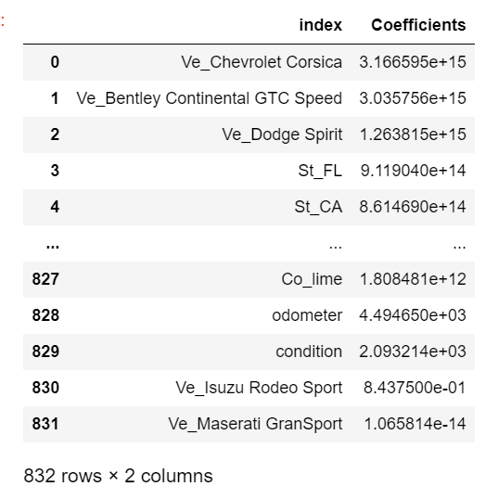
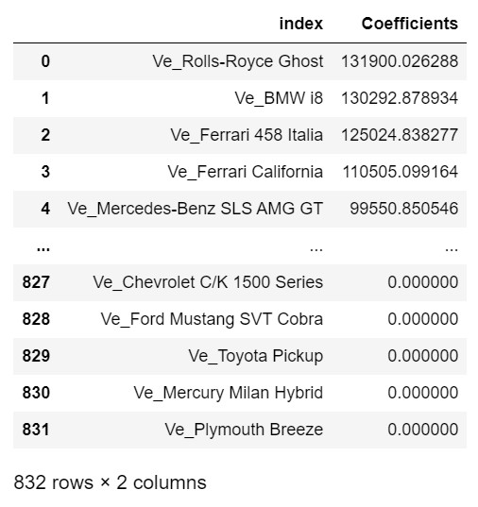
Feature Selection: Linear Model
Left table shows absolute value of coefficients in linear model without regularization and right hand side shows absolute value of coefficients in linear model with LASSO regularization.
Note many coefficients in LASSO are driven to zero since L1 norm favors a sparse solution, i.e., a few entries in the parameter vector vanish.

Slide 4
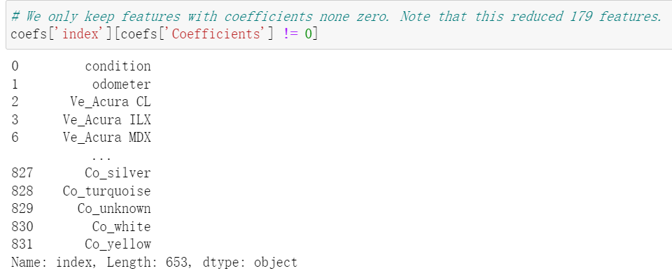
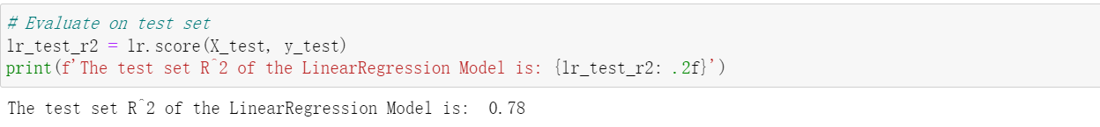
Feature Selection: Linear Model
We only choose the parameter with nonzero coefficient, this reduced 179 features.
We also calculate the R-Squared value of regularized linear model on test set and find out that it has the same performance as the unregularized one.

Slide 5
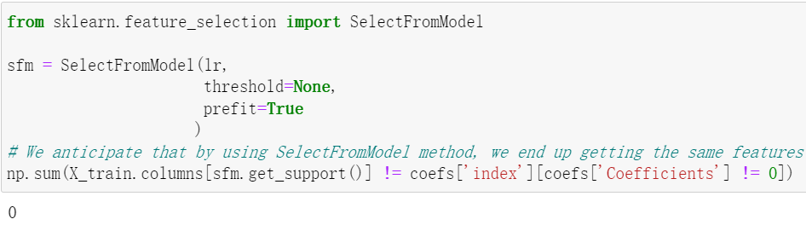
Feature Selection: Linear Model
We also used SelectFromModel method and set the threshold to be 1e-5, which is same the LASSO.
As we expected, it chose the same features as LASSO did.

Slide 6
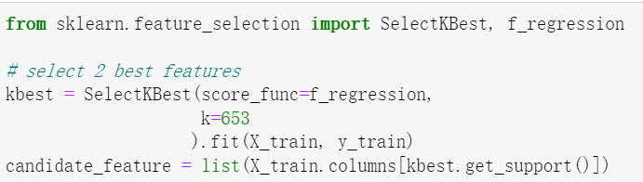
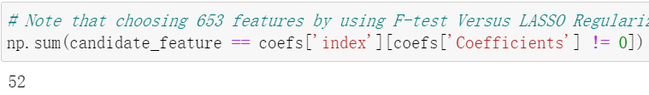
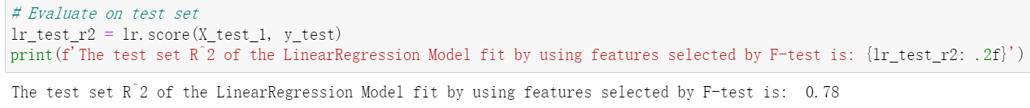
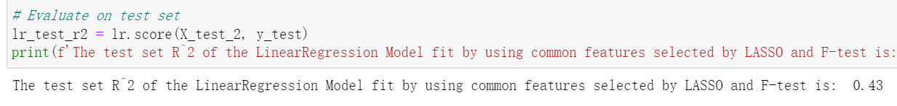
Feature Selection: Linear Model
We then used F-test to select the same number of features as LASSO did and compared the results.
We end up getting that only 52 out of 653 features are selected by both F-test and LASSO.
We calculated the R-Squared value of linear model by using features selected by F-test and by using only common features. The former outputs the same value as regularized linear model and the latter has much worse performance.

Slide 7
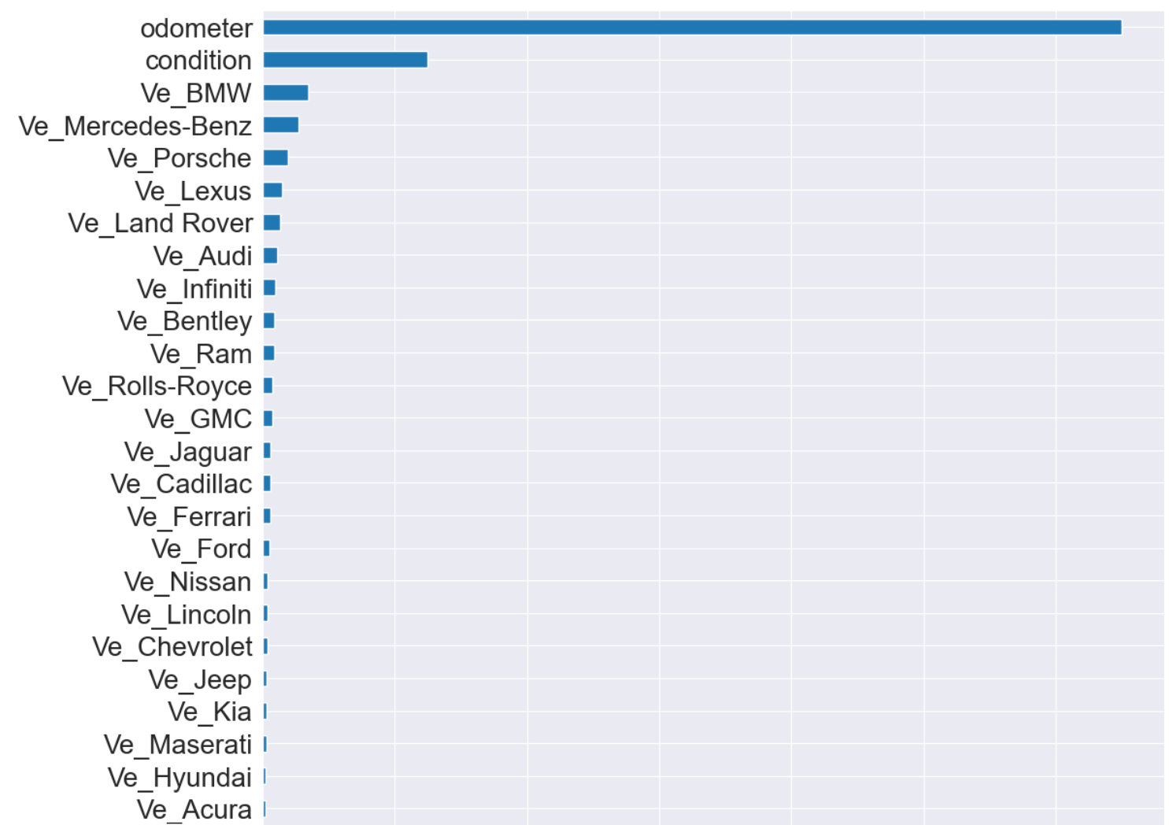
Feature Selection: Random Forest
This graph shows part of the feature importance in random forest model.
Note that many features have very little importance and this provides us a method to conduct feature selection.

Slide 8
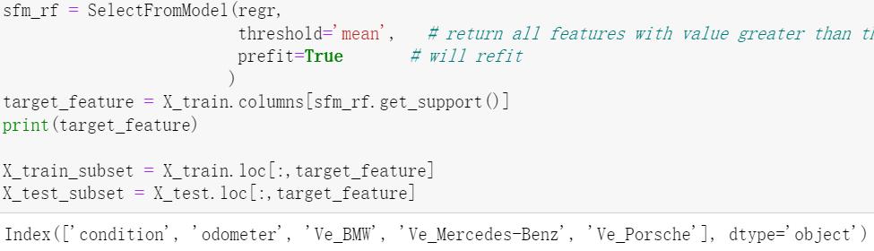
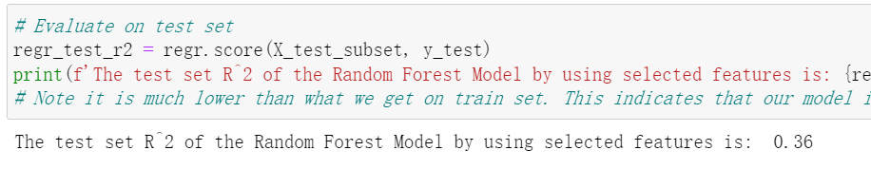
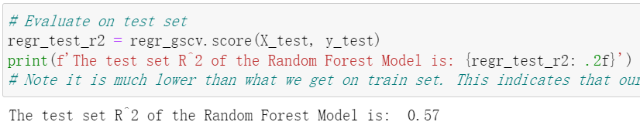
Feature Selection: Random Forest
We decided to choose features with importance greater than the mean importance of all features.
This gave us the following features: ‘condition’, ‘odometer’, ‘Ve_BMW’, ‘Ve_Mercedes-Benz’, and ‘Ve-Porsche’.
We then calculated the R-Squared value of random forest model fit by using only above features and got 0.36 which is lower than the R-Squared value of original random forest model 0.57.

Slide 9
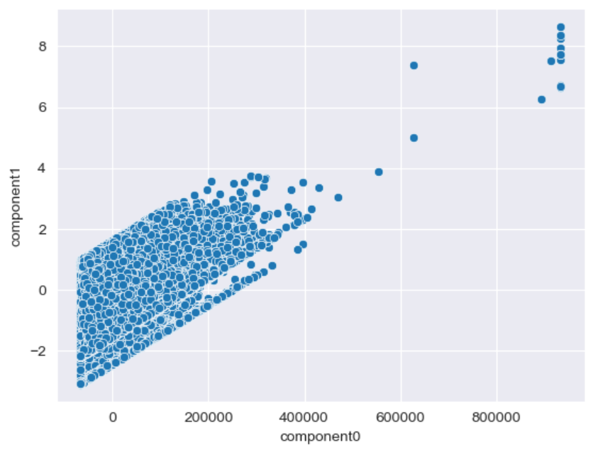
Dimensionality Reduction with PCA
We decided to reduce the original data set with 55 features to only two components. And the graph shows how data looks like in the subspace spanned by the two components.

Slide 10
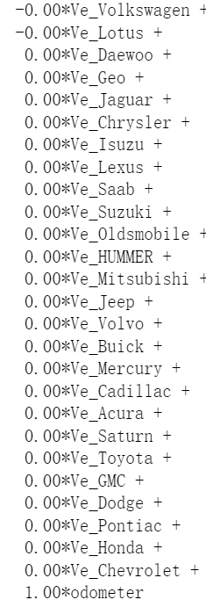
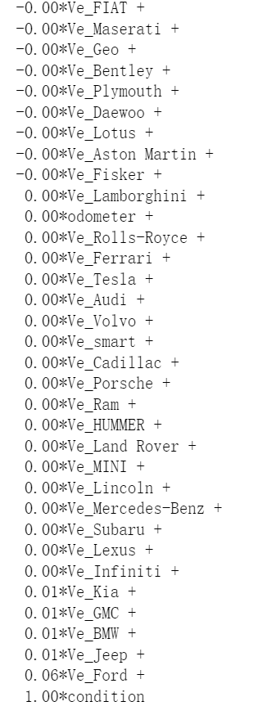
Dimensionality Reduction with PCA
The left tables gave how each component is consist of original features.
We found that component 0 is mainly consist of odometer and component 1 is mainly consist of condition. This inspired us to draw the scatter plot of odometer versus condition and its corresponding PCA transformation plot.

Slide 11
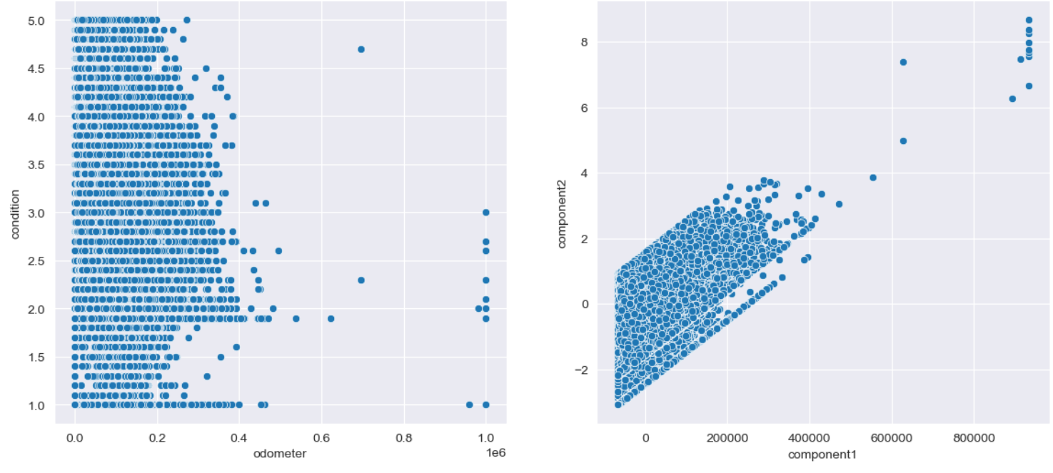
Dimensionality Reduction with PCA
This looks exactly like the PCA plot of full data set, which also supports that odometer and condition together can explain most variation in car auction price.

Slide 12
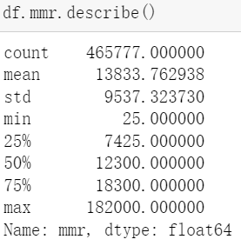
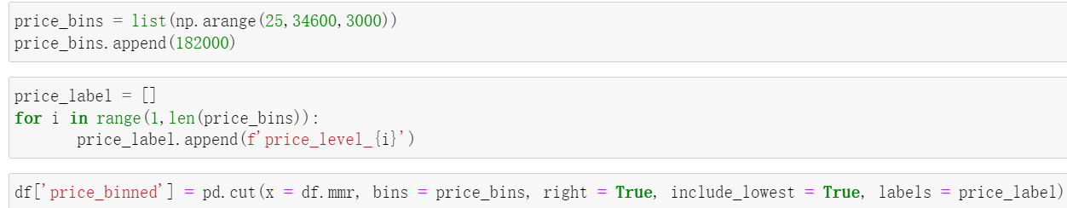
Recommendation Engine
We choose to use content-based filtering. In order to be able to compute the similarity of each vehicle, we need to do some variable transformations
We first modify mmr variable which is the market estimated price for the car. We want to classify vehicle into several groups according to its estimated price. For example, start from the minimum value, every 5000 dollar will become a group.
The left table shows that the maximum value of mmr is far greater than the upper quantile, which suggests there are some outliers. We decide to treat the outliers as one group and divide the rest evenly.

Slide 13
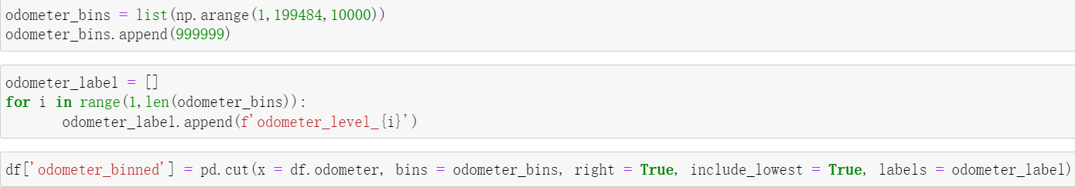
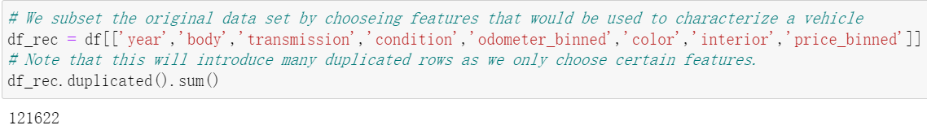
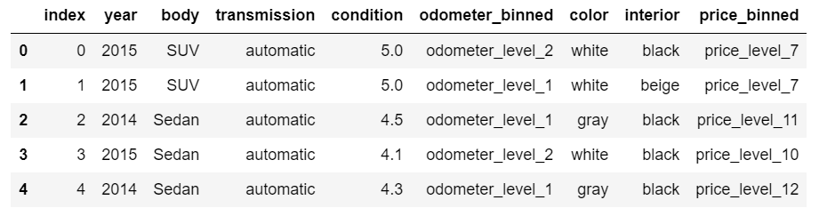
Recommendation Engine
We used similar way to process odometer variable which refers to the distance the car has travelled since manufactured.
We only choose part of features to characterize a vehicle. And this introduced many duplicated rows. After deletion, the bottom table shows how the final data looks like.

Slide 14
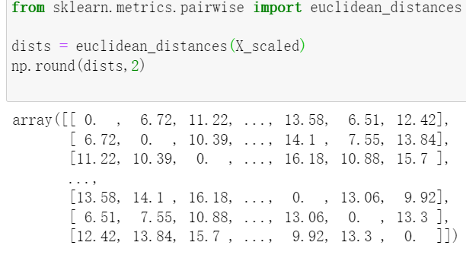
Recommendation Engine
After converting the categorical variables to dummy variables and standardizing all features, we computed the euclidean distances pairwisely.
Due to the limit capacity of the in-memory storage, we only chose 10000 records.
The left matrix shows the distance between pairs. Small value indicates two vehicles are similar and large value indicates two vehicles are different.

Slide 15
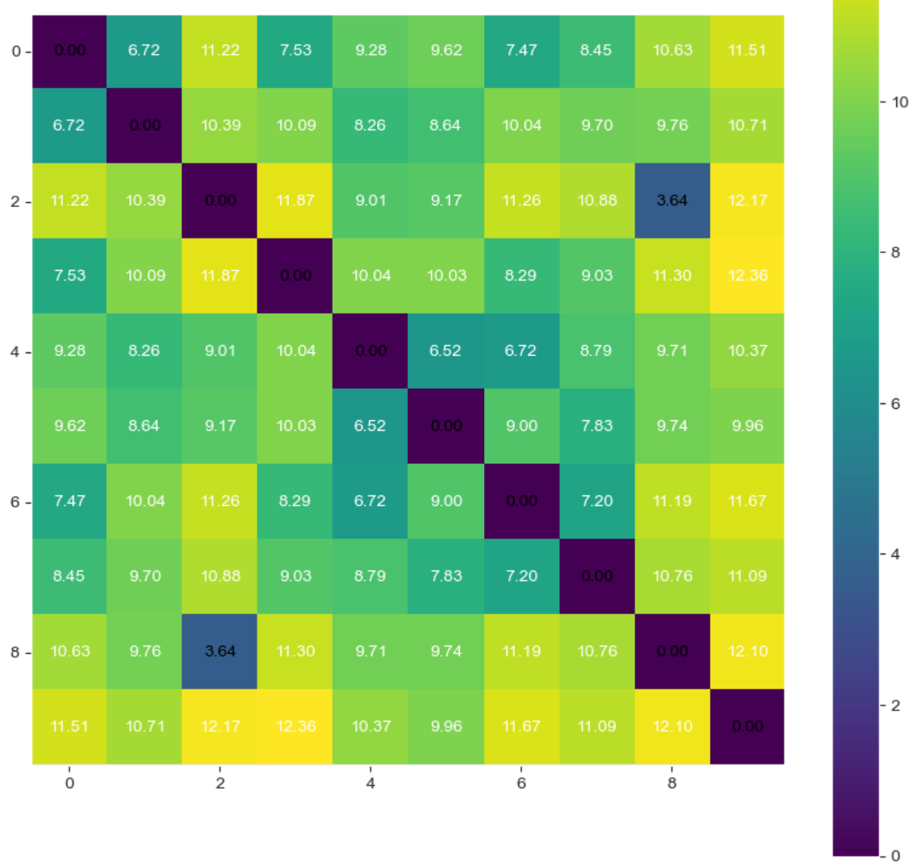
Recommendation Engine
The heat map visualized the distance between the first ten vehicles.
The darker the block is the more similarity the corresponding two vehicles share.
We can observe that vehicle 10 is different from all other 9 vehicles.

Slide 16
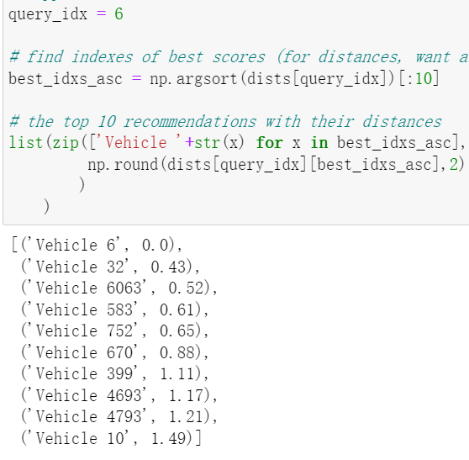
Recommendation Engine
We want to check if this recommendation engine makes sense.
Suppose we are interested in vehicle 6, we want to see all vehicles that are similar to vehicle 6.
The left tables listed top 10 vehicles that are most similar to vehicle 6.

Slide 17
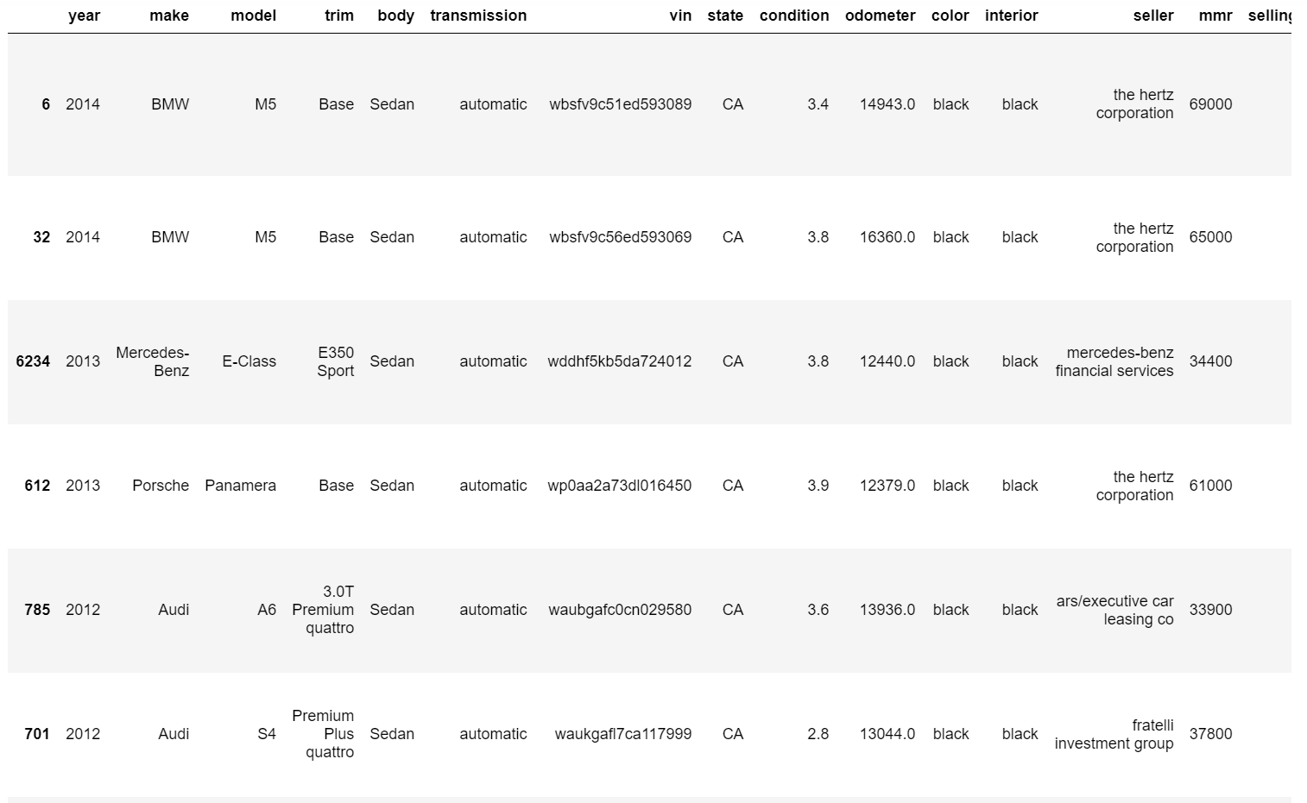
Recommendation Engine
We go back to the original data to see how recommended vehicles look like.
In terms of year, body, transmission, condition, odometer, color, and estimated price, those cars are very similar.
And we also found that the brands of those cars are competitors of each other as the target customer of BMW tend to be also interested in Mercedes-Benz or Audi. This suggests that our recommendation engine works well.

